Slide 2
Pilkington Austria
Value-Added Products

Slide 3
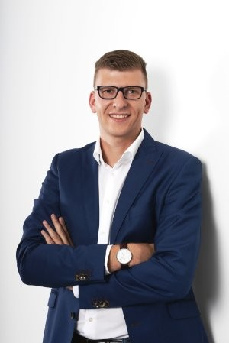
Short introduction
Michael Lackner
Product Manager
Pilkington Austria GmbH
Werksgelände 24
A-5500 Bischofshofen
M: +43 664 1603735
E: michael.lackner@at.nsg.com
W: www.pilkington.at
Pilkington Austria image video:
https://www.youtube.com/watch?v=BChh_vaUQoI&t=2s

Slide 4
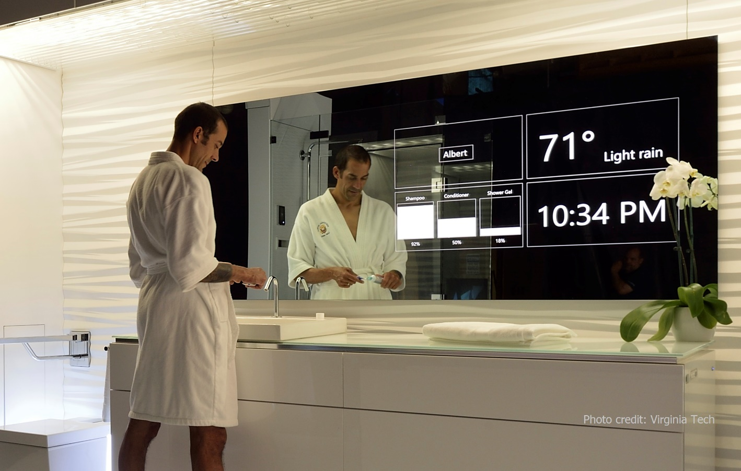
Pilkington MirroView™
Transparent mirror for digital applications

Slide 5
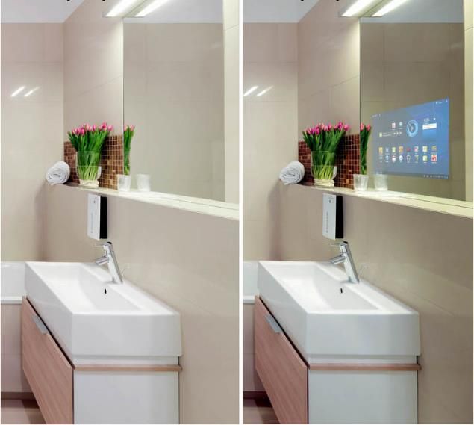
Pilkington MirroView™
Product description:
Pyrolytic, highly-reflective mirror coating
Electrically not conductive (compatible w/ PCAP touch)
Application as a mirror with hidden display
Suitable for commercial and private use
Function:
OFF ON

Slide 6
Pilkington MirroView™
Product family consisting of:
Pilkington MirroView™
Pilkington MirroView™ 50/50
Technical data:
Product | Thickness (mm) | Subs-trate | Light trans-mission (%) | Reflexion coating side (%) | Reflexion glass side (%)
Pilkington MirroView™ | 4 | Clear | 25 | 65 | 60
 | 6 | Clear | 25 | 65 | 59
Pilkington MirroView™ 50/50 | 6 | Clear | 35 | 53 | 48
We recommend Pilkington MirroView™ to our customers!

Slide 7
Applications
Hotels und reception areas
Retail and changing rooms
Banks
Fitness studios
Gastronomy
Bathrooms

Slide 8
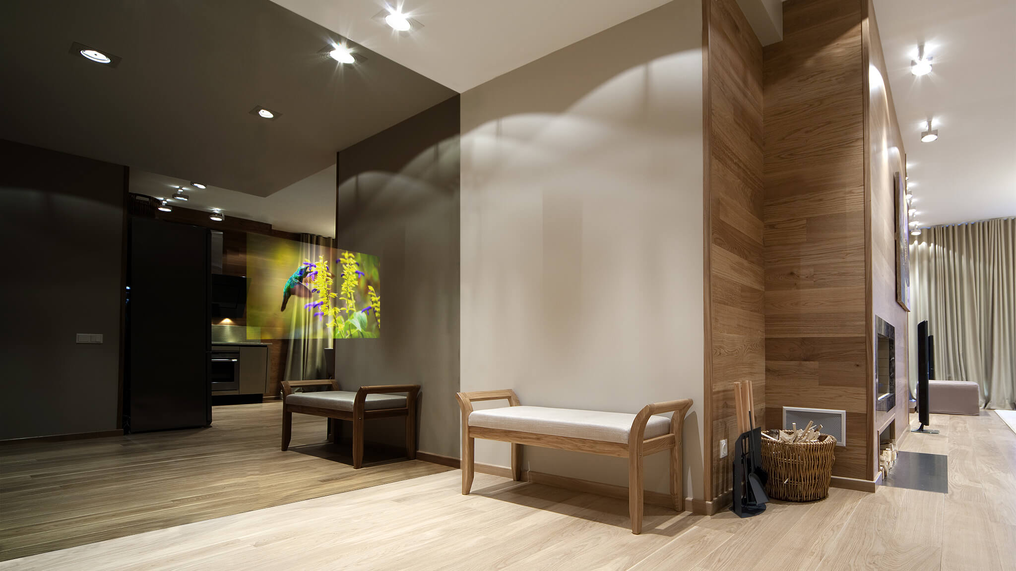
Hotels and reception areas

Slide 9
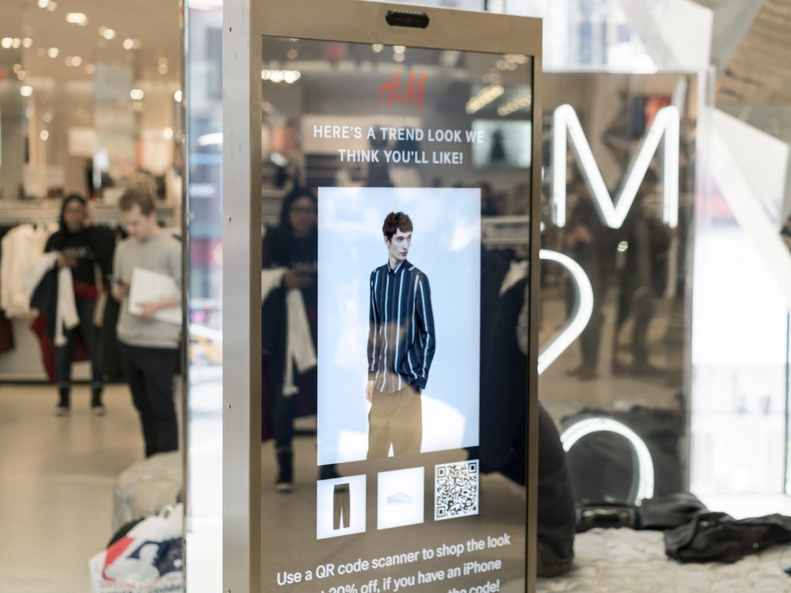
Retail and changing rooms

Slide 10
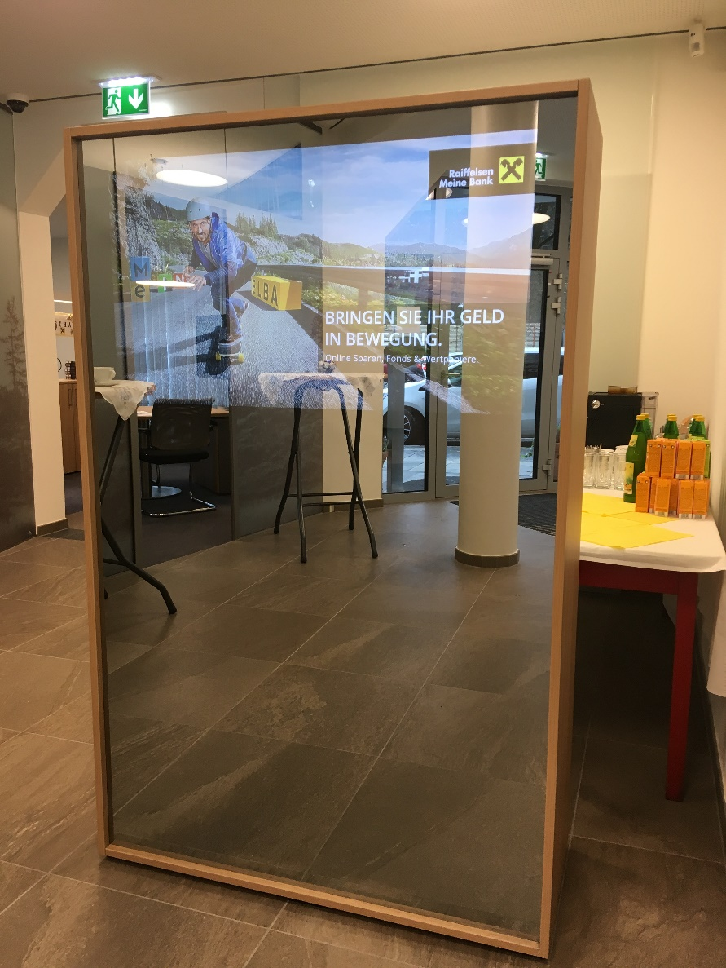
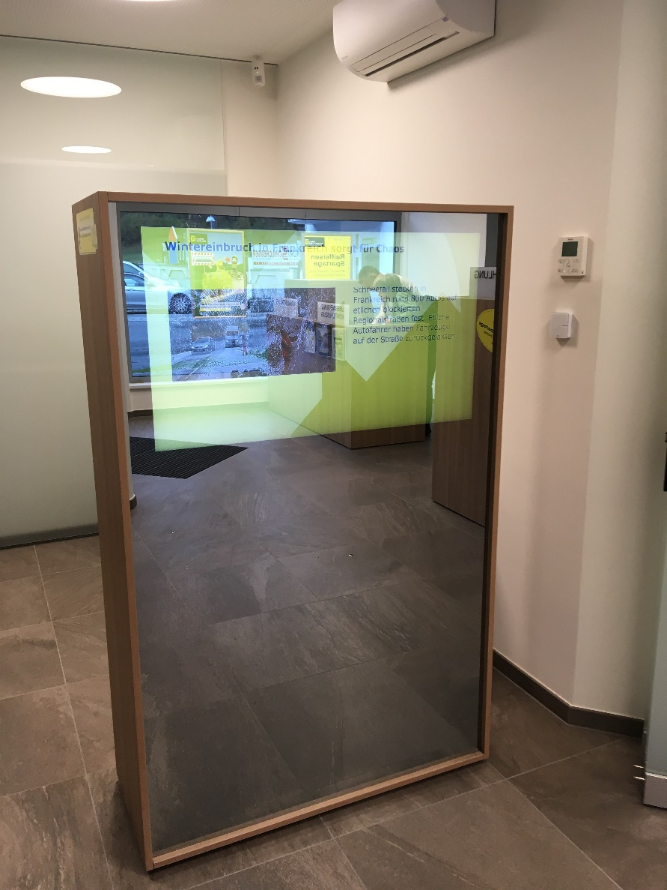
Banks

Slide 11
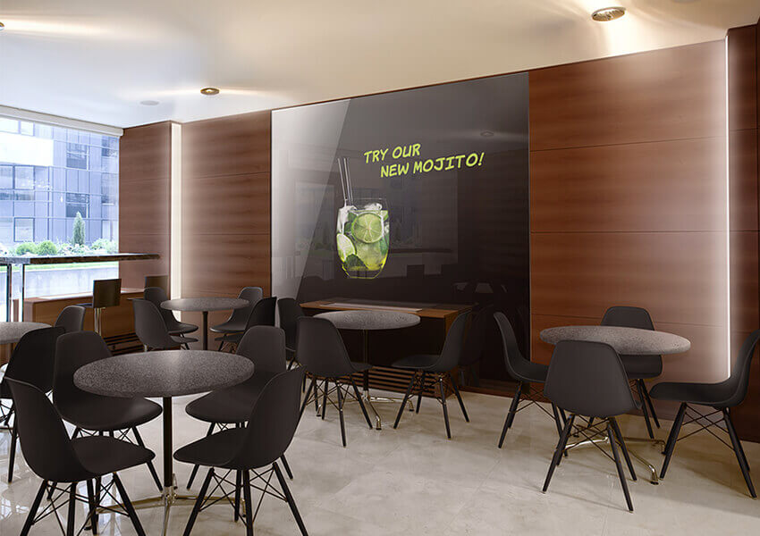
Gastronomy

Slide 12
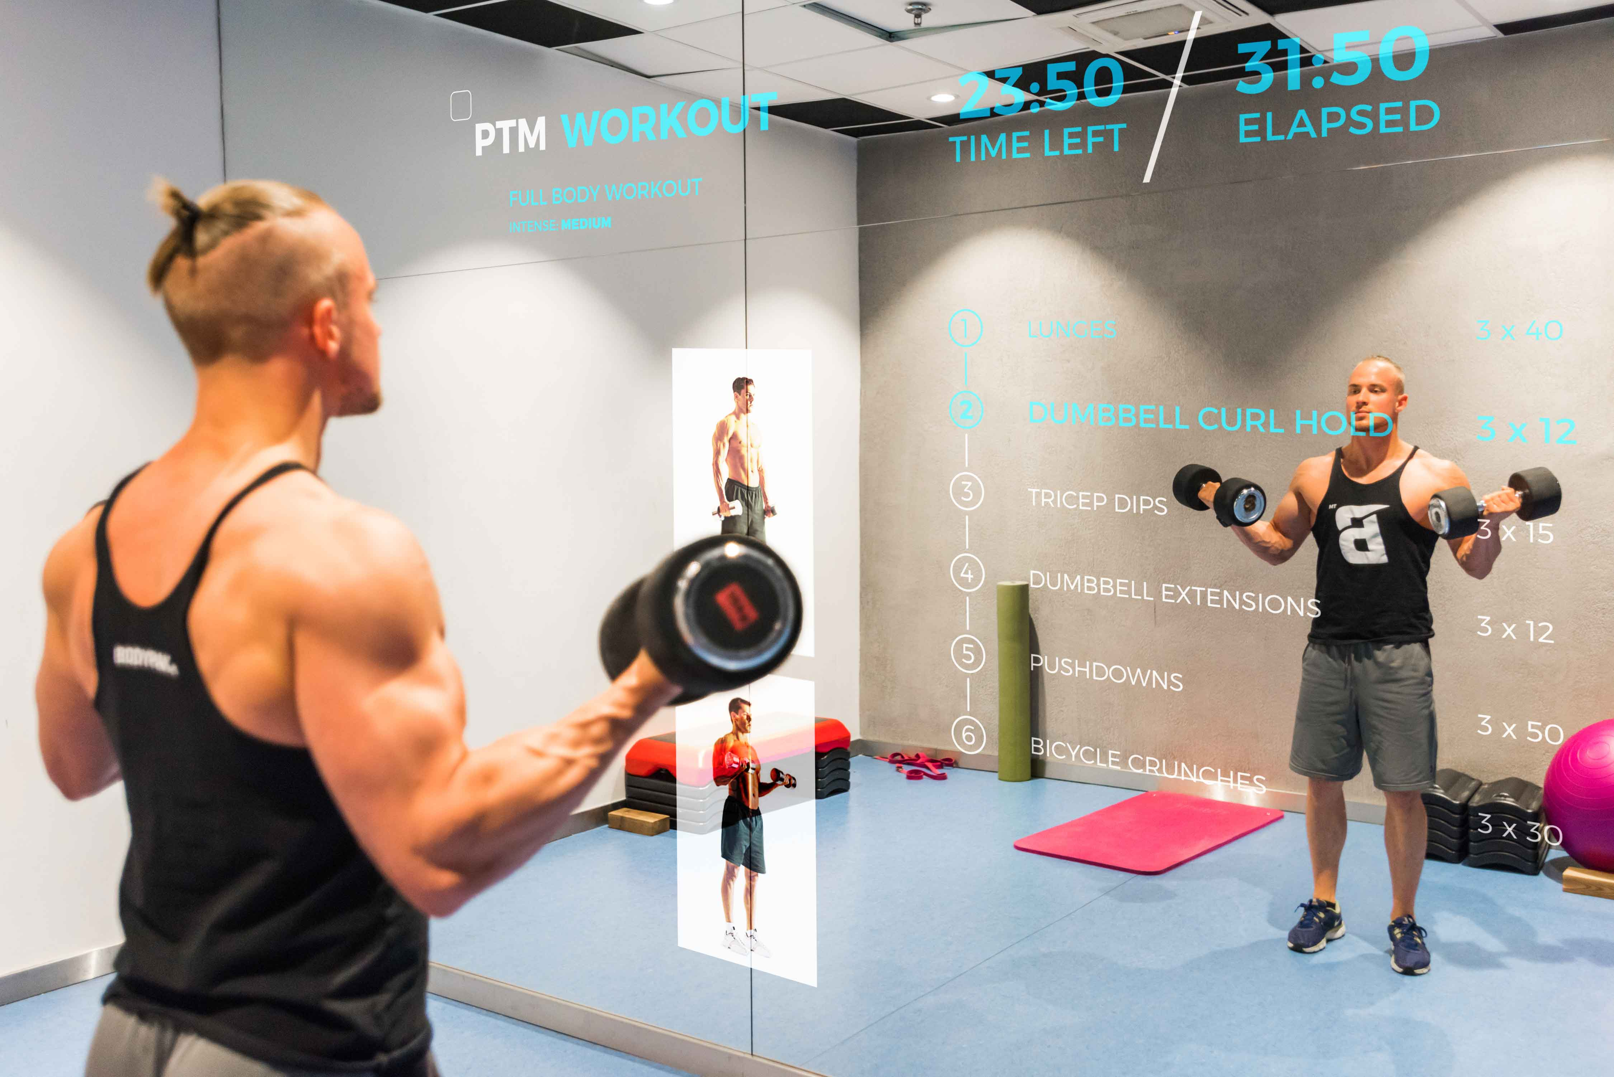
Fitness studios

Slide 13
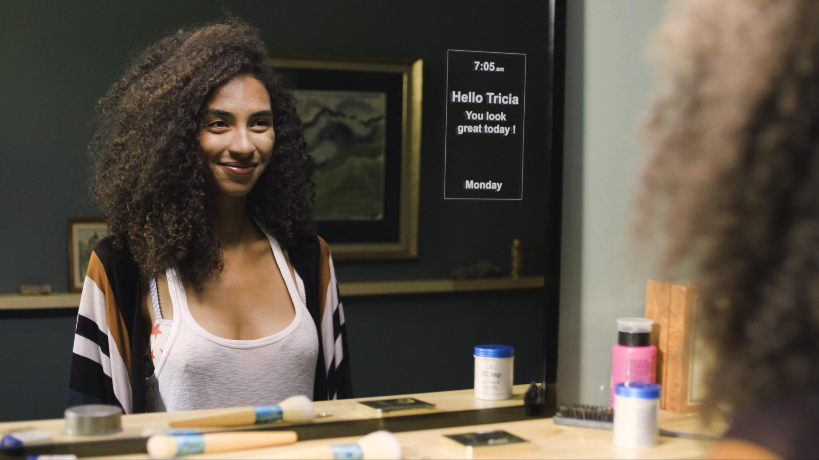
Bathrooms

Slide 14
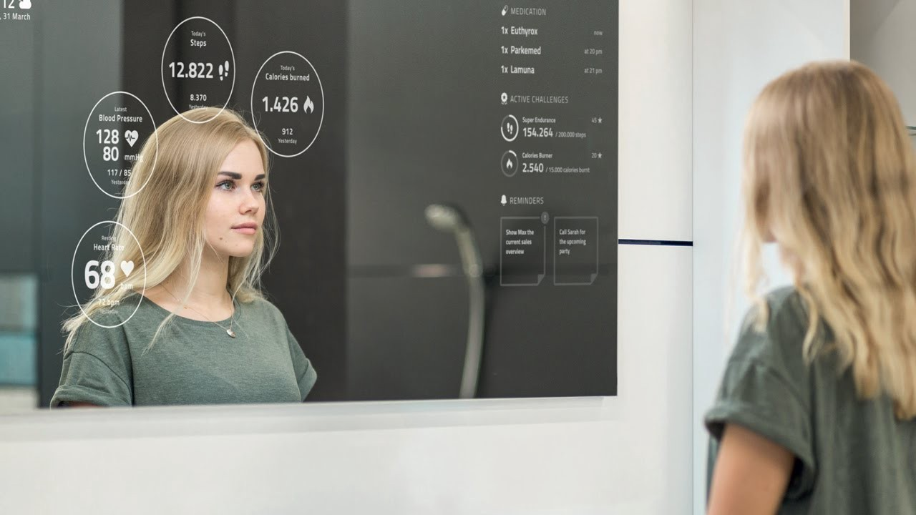
Pilkington MirroView™ Smart
Versatile. Esthetic. Smart.

Slide 15
Pilkington MirroView™ Smart
Smart Mirror developed by Pilkington Austria
Pilkington MirroView™ 6 mm, toughened, part enamelled
Public Info Display (43” to 75” models available)
High light output (700 cd/m2), 24/7 operation
Optionally available:
Frame for wall-mounting
PCAP touch screen
Remote maintenance service
SmartFeedback system (SW)

Slide 16
Customizations and services
Pilkington MirroView™ Smart adjustments:
Glass dimension (width and height)
Part enamelling area
Number and size of the display(s)
Positioning of the display(s)
Additional services available:
Planning, installation, commissioning and maintenance
Consulting and creation of multimedia content
Right product, right place!

Slide 17
Pilkington MirroView™ Smart
Available Public Info Displays:
Screen diagonal (inches) | Resolution | Aspect ratio | Dimensions W x H x D (mm) | Brightness (cd/m²) | Contrast ratio
43“ (Full HD) | 1920 x 1080 | 16:9 | 960 x 550 x 30 | 700 | 3000:1
49“ (Full HD) | 1920 x 1080 | 16:9 | 1093 x 625 x 30 | 700 | 4000:1
55“ (Full HD) | 1920 x 1080 | 16:9 | 1228 x 701 x 30 | 700 | 5000:1
43” (4K) | 3840 x 2160 | 16:9 | 968 x 558 x 48 | 500 | 4000:1
49” (4K) | 3840 x 2160 | 16:9 | 1099 x 632 x 46 | 500 | 4000:1
55“ (4K) | 3840 x 2160 | 16:9 | 1235 x 708 x 46 | 500 | 4000:1
65“ (4K) | 3840 x 2160 | 16:9 | 1454 x 831 x 46 | 500 | 4000:1
75” (4K) | 3840 x 2160 | 16:9 | 1681 x 960 x 50 | 500 | 4000:1
Watch Pilkington MirroView™ Smart on Youtube!

Slide 18
SmartFeedback Demo

Slide 19
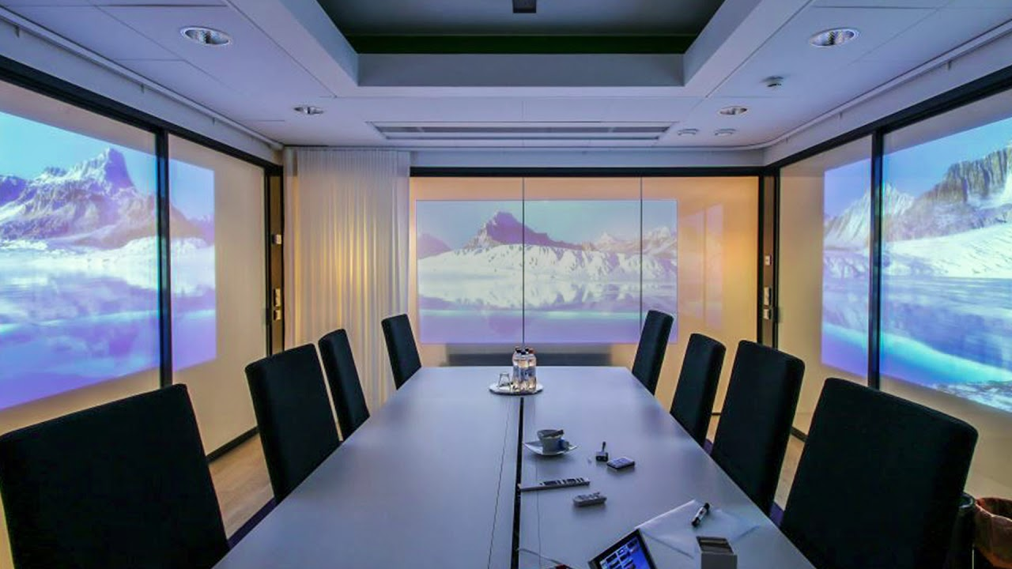
Pilkington ViewControl™
Switchable. Multifunctional. Private.

Slide 20
Pilkington ViewControl™
Switchable glass at push of a button
Switches from opaque to transparent
OFF mode: opaque
ON mode: transparent
PDLC film (Polymer Dispersed Liquid Crystal)
Glass structure:
Pilkington Optiwhite™ toughened/heat strengthened
EVA film – PDLC film – EVA film
Pilkington Optiwhite™ toughened/heat strengthened
Busbars for electrical connection

Slide 21
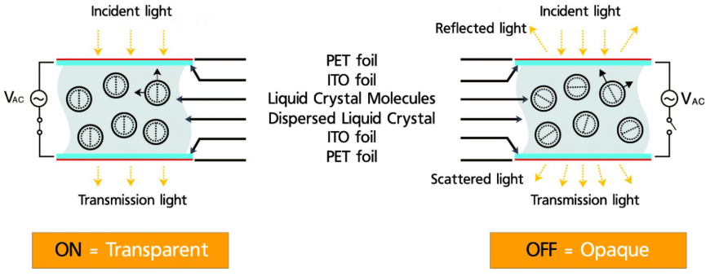
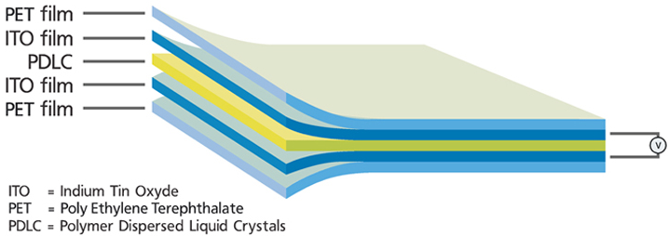
Function principle and film structure

Slide 22
Technical data
Description |  | Mode | Values
Operation mode | Power | ON OFF | Transparent Opaque
Electrical properties | Operating voltage Operating temperature Power consumption Available Power Supplies | ON ON / OFF ON | 60 VAC (50 / 60 Hz) -20 ~ +60 °C 3 - 5 W/m² 60 VAC / 35 W (up to 1,5 m²) 60 VAC / 100 W (up to 5 m²) 80 VAC / 100 W (up to 4,5 m²)
Film properties | Width Length Colour Visible Light Transmittance Haze Switch time Life time | ON OFF ON ON / OFF | Up to 1800 mm Up to 3500 mm White 75 % 55 % 5 % < 0,1 sec > 10 years
Glass properties | Mono glasses Construction |  | Pilkington Optiwhite™ Laminated glass 44.4, 66.4, 88.4 out of toughened / heat strengthened glass
Additional properties | Rear projection Controlling possibilities | OFF | Available Switch, bus connection, remote control

Slide 23
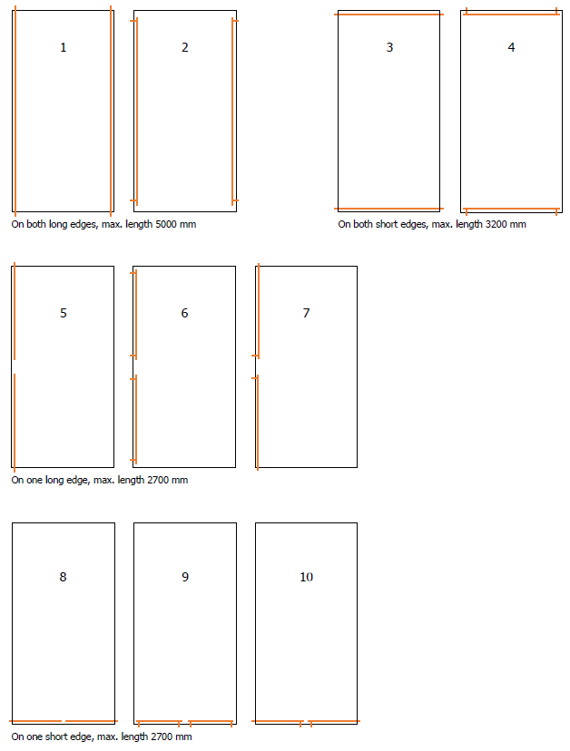
Busbar alignment

Slide 24
Applications
Meeting rooms
Mobile partitions
Windows & Doors
Bathrooms
Hospitals
Back projections

Slide 25
Demo

Slide 26
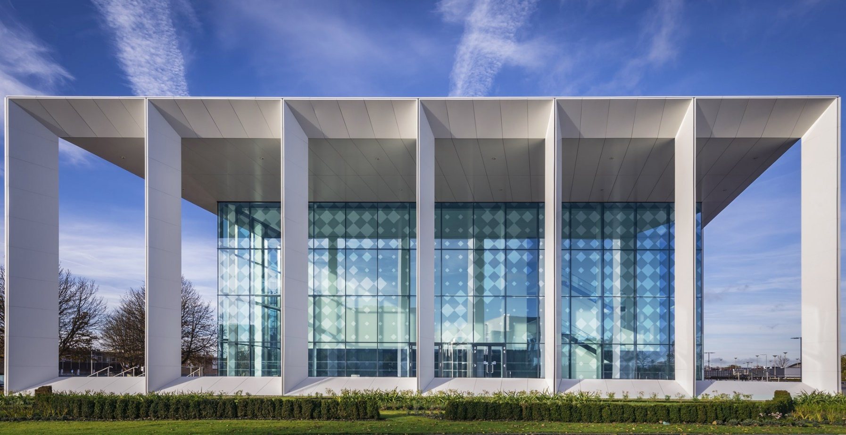
Pilkington DesignPrint
Aesthetic. Individually. Resistant.

Slide 27
Construction of print heads

Slide 28
Colour system

Slide 29
Digital printer – drop sizes
7 different drop sizes
Smaller drop sizes -- better resolution
Bigger drop sizes -- higher opaqueness

Slide 30
Technical data
Glass thicknesses: From 4 to 19 mm
Maximum glass sizes: From 200 x 300 mm, to 2500 x 4500 mm
Resolutions: From 360 to 1440 dpi
Supported file formats: PDF, CDR, AI, BMP, PSD, TIFF, JPEG, GIF, PNG
Translucency: Colour gradients and graduations possible
Special colours: Etching-, transparent- and metallic effect, non-slip-, gold and platinum colours
Compliances All colours are RoHS compliant
Resistances: Colours can be used on layer 1

Slide 31
Pilkington Suncool™ Dynamic
Easy. Dynamic. Maintenance-free.

Slide 32
Pilkington Suncool™ Dynamic

Slide 33
Pilkington Suncool™ Dynamic
People should feel comfortable in their homes
How can glass contribute?
Light transmission
Thermal insulation
Sun protection
Optics and aesthetics
But: most glasses are static, but not the weather!
Idea: Adaptive glass!

Slide 34
What is Pilkington Suncool™ Dynamic?
Pilkington Suncool™ Dynamic
Thermochromic laminated safety glass *!
Thermochromic:
Change in the transmission of solar radiation as a function of the glass transition temperature
* according to Din EN 14449, laminated safety glass out of heat strengthened glass

Slide 35
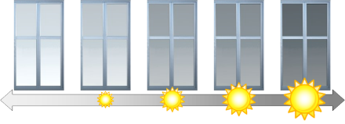
Basic idea
Strong sunlight → high absorption → high glass temperature → strong tinting
Low temperature → low absorption → low glass temperature → no tinting

Slide 36
Technical data
Product | Form | Light transmission, T_{L} (%) | Solar heat gain coefficient, g-value (%)
Pilkington Suncool™ Dynamic Mono (laminated safety glass) | clear | 62 | 67
 | tinted | 10 | 44
Pilkington Suncool™ Dynamic double IGU – U_{g} value 1,1 | clear | 56 | 46
 | tinted | 9 | 21
Pilkington Suncool™ Dynamic double IGU – U_{g} value 1,0 | clear | 48 | 34
 | tinted | 8 | 14
Pilkington Suncool™ Dynamic triple IGU – U_{g} value 0,7 | clear | 51 | 39
 | tinted | 9 | 16
Pilkington Suncool™ Dynamic 9.2 mm meets the impact test requirements of EN 12600 (pendulum test 1B1)

Slide 37
Advantages
Adapted sunscreen at any time of the year or day
No electricity
Maintenance-free
Automatic tinting
Reduced glare
UV protection (protects against fading)
Advantages over static glass

Slide 38
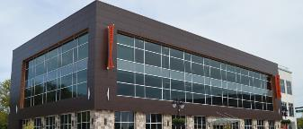
Combination possibilities
Pilkington Optitherm™
Thermal insulation
Pilkington OptiView™
Anti-reflection
Pilkington Suncool™
Additional sunscreen
Pilkington Activ™
Self-cleaning
Right product, right place.

Slide 39
Availability
Pilkington Suncool™ Dynamic from toughened float glass:
9,2 mm laminated: 1638 x 2850 mm
11,2 mm laminated: 1638 x 3000 mm
13,2 mm laminated: 1638 x 4000 mm
17,2 mm laminated: 1638 x 4000 mm
Pilkington Suncool™ Dynamic from heat-strengthened float glass:
9,2 mm laminated: 1638 x 2500 mm
11,2 mm laminated: 1638 x 3000 mm
13,2 mm laminated: 1638 x 4000 mm
17,2 mm laminated: 1638 x 4000 mm
Weight limit:
Max. 250 kg per mono glass
Max. 500 kg per laminated glass

Slide 40
Pilkington Mirropane™ Chrome
Esthetic. Safe. Durable.

Slide 41
Pilkington Mirropane™ Chrome

